Slide 1
Changing the subject with more complex formula
Expressions and formulae

Slide 2
How our teaching resources are designed for the classroom

Slide 3
I can apply an understanding of inverse operations to a complex formula in order to make a specific variable the subject.

Slide 4


The subject of an equation/a formula is a variable that is expressed in terms of other variables. It should have an exponent of 1 and a coefficient of 1.
For example, a is the subject of this formula
but, a² is not the subject of this formula

Slide 5

Changing the subject with more complex formula
Changing the subject with two steps
Rearranging more complex formulae

Slide 6
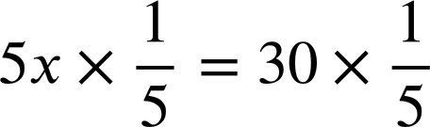
Changing the subject with two steps
Rearranging is a key skill in mathematics. It helps us in a lot of situations.
For example, how we solve this equation.
5x + 12 = 42
We are trying to isolate the x
5x + 12 − 12 = 42 − 12
Same operation both sides to maintain equality
5x = 42 − 12
A rearrangement of 5x + 12 = 42
5x = 30
RHS simplified but x is not yet isolated
Multiply both sides by the reciprocal of 5
x = 6
x is now isolated

Slide 7

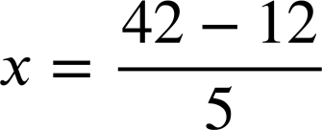
Changing the subject with two steps
Rearranging is a key skill in mathematics. It helps us in a lot of situations.
For example, how we solve this equation.
5x + 12 = 42
We performed two inverse operations of −12 and in order to isolate x
5x = 42 − 12
A rearrangement of 5x + 12 = 42
A rearrangement of 5x = 42 − 12 whereby…
A rearrangement of 5x = 42 − 12 whereby… x is now the subject.
When rearranging the subject can often be thought of as the unknown you are trying to find the value of.

Slide 8
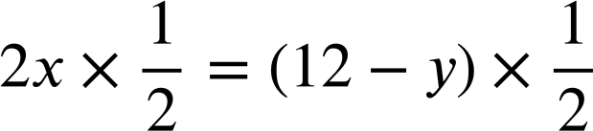
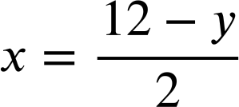
Changing the subject with two steps
We are not always seeking to find a given value, like a solution to an equation, when rearranging.
For example, the linear function 2x + y = 12
This form enables us to efficiently graph the line.
(0, 12)
(6, 0)
For any additive relationship like this we can quickly see four arrangements.
2x + y = 12
y = 12 − 2x
With y as the subject we immediately know the gradient, −2
y + 2x = 12
2x = 12 − y
With x as the subject we can efficiently find the x coordinate if we know y

Slide 9
Changing the subject with two steps
For the linear function 3x + y = 15 make y the subject.
Option one:
Inverse operations.
Option two:
The four arrangements of this additive relationship.
3x + y = 15
3x + y = 15
3x = 15 − y
3x + y − 3x = 15 − 3x
y + 3x = 15
y = 15 − 3x
y = 15 − 3x

Slide 10
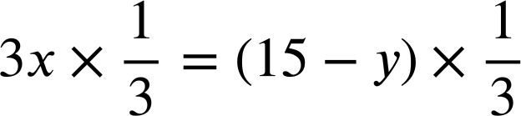
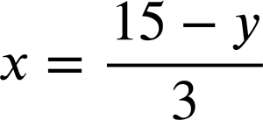
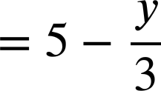
Changing the subject with two steps
For the linear function 3x + y = 15 use inverse operations to make x the subject.
3x + y = 15
3x + y − y = 15 − y
Inverse of + y
3x = 15 − y
Inverse of ×3

Slide 11
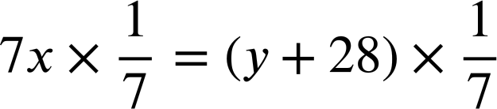
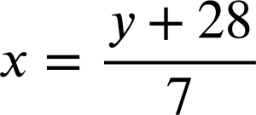
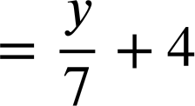
Changing the subject with two steps
For the linear function 3x + y = 15 use inverse operations to make x the subject.
For the linear function 7x − y = 28 use inverse operations to make x the subject.
3x + y = 15
7x − y = 28
3x + y − y = 15 − y
7x − y + y = 28 + y
3x = 15 − y
7x = 28 + y

Slide 12
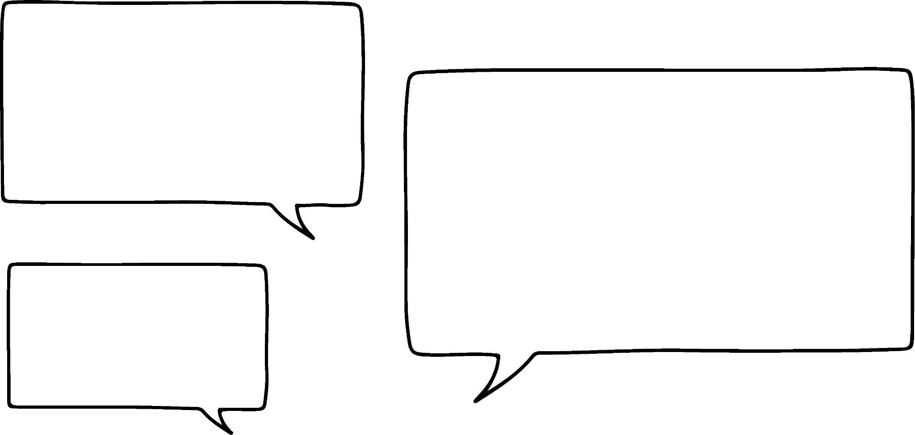


Changing the subject with two steps
Alex and Aisha are writing formula.
Formula one: d plus 5 then divided by 2 makes e
Formula two: d divided by 2 then plus 5 makes e
I think we’ll get two very different formulae!
They both say, “plus 5” and “divide by 2” so I think we’ll get the same formula.
Who do you agree with?

Slide 13
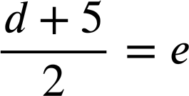
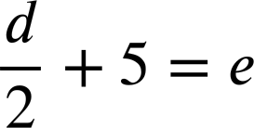
Changing the subject with two steps
Alex and Aisha are writing formula.
Formula one: d plus 5 then divided by 2 makes e
Formula two: d divided by 2 then plus 5 makes e
I think we’ll get two very different formulae!
They both say, “plus 5” and “divide by 2” so I think we’ll get the same formula.
Thanks Aisha! I can see that order matters now.

Slide 14
Changing the subject with two steps
The order will matter when we rearrange these formula.
Formula one: d plus 5 then divided by 2 makes e
Formula two: d divided by 2 then plus 5 makes e
If we wanted to make d the subject the inverse operations for both are −5 and ×2 but the order in which we apply them matters.

Slide 15
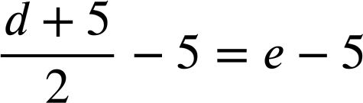
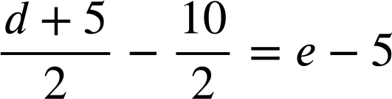
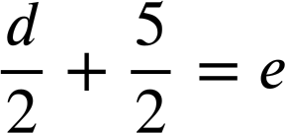
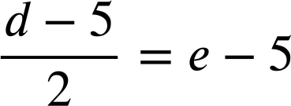
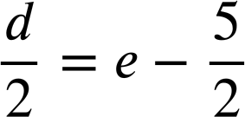
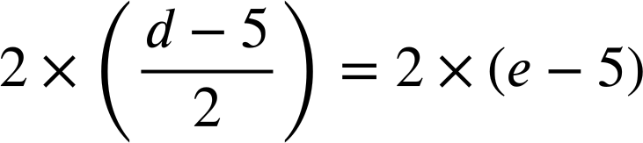
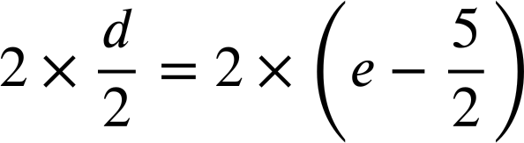


Changing the subject with two steps
Formula one:
This was really inefficient because this is not really a 5
−5 first

Slide 16
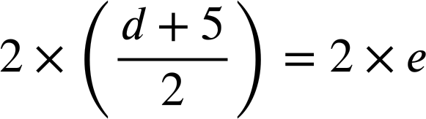

Changing the subject with two steps
Formula one:
×2 first
This method is much more efficient!
When rearranging equations and formula involving fractions it’s sensible to consider which order to proceed with.

Slide 17
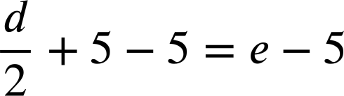
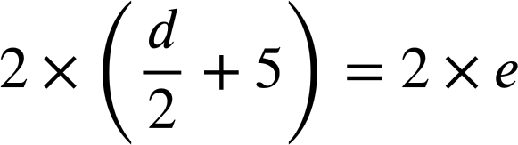
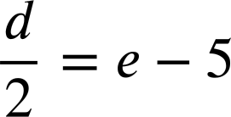

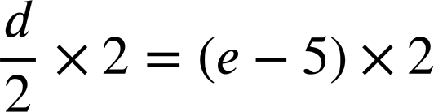



Changing the subject with two steps
Formula two:
−5 first
×2 first
Be sure to multiply all terms by 2
Not much difference in efficiency between the two methods.

Slide 18
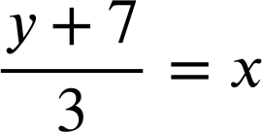

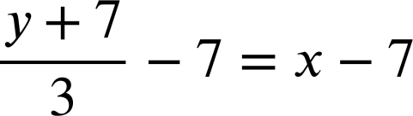

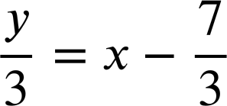


Changing the subject with two steps
Which is the most efficient first step to take when rearranging this formula?
−7 on both sides
Really inefficient!
on both sides
It will work but it’s not the most efficient.
×3 on both sides
Highly efficient!

Slide 19
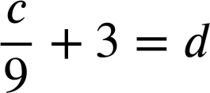
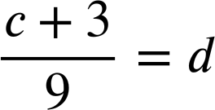
Changing the subject with two steps
1) Rearrange each formula to make c the subject.
a)
6c + 7 = 19
b)
3c + 8 = d
c)
3d − c = 19
d)
d − 3c = 19
e)
f)

Slide 20
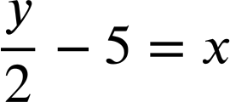
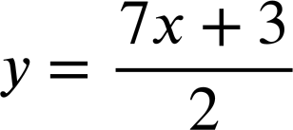

Changing the subject with two steps
2) Laura has been rearranging these equations to make y the subject.
a)
2y + 3x = 18
b)
c)
2y + 3 = 7x
2y = 18 − 3x
2y = 7x + 3
y − 5 = 2x
I have checked my answers and they are all wrong. Can you help me spot where I went wrong?
y = 2x + 5
In each case circle Laura’s errors and write a sentence to explain what she should do differently.

Slide 21
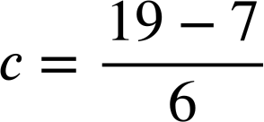
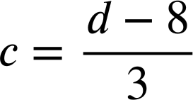
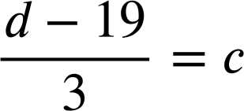
Changing the subject with two steps
1) Rearrange each formula to make c the subject.
a)
6c + 7 = 19
b)
3c + 8 = d
6c = 19 − 7
3c = d − 8
c)
3d − c = 19
d)
d − 3c = 19
d = 19 + 3c
3d = 19 + c
d − 19 = 3c
3d − 19 = c

Slide 22
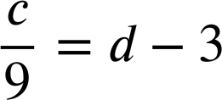




Changing the subject with two steps
1) Rearrange each formula to make c the subject.
e)
f)

Slide 23
Changing the subject with two steps
2) Laura has been rearranging these equations to make y the subject.
a)
2y + 3x = 18
b)
c)
2y + 3 = 7x
2y = 18 − 3x
2y = 7x + 3
y − 5 = 2x
For y to be the subject the coefficient needs to be 1. Divide both sides by 2
y = 2x + 5
When multiplying both sides by 2 be sure to multiply all terms. This line should read y − 10 = 2x
You meant to add −3 to both sides

Slide 24
Changing the subject with more complex formula
Changing the subject with two steps
Rearranging more complex formulae

Slide 25
Rearranging more complex formula
Some of the formula we need to rearrange will involve exponents.
For example, make x the subject.
y = x² + 5
We treat this case no differently. We still use inverse operations.

Slide 26


Rearranging more complex formula
Some of the formula we need to rearrange will involve exponents.
For example, make x the subject.
y = x² + 5
y − 5 = x²
+(−5) to both sides.
Next we need the inverse of squaring.
x is now the subject.

Slide 27


Rearranging more complex formula
Laura is rearranging this equation to make x the subject.
y = x² − 9
y + 9 = x²
16 + 9 = 25
Is this an equation?
The inverse of squaring is to square root so can I do this?
I don’t know but we could test it with a numerical example.

Slide 28

Rearranging more complex formula
Laura is rearranging this equation to make x the subject.
y = x² − 9
y + 9 = x²
16 + 9 = 25
So, I can’t take the root of each term. I have to group them.
4 + 3 ≠ 5
So, y + 9 = x² becomes

Slide 29
Rearranging more complex formula
Laura is rearranging this equation to make x the subject.
y = x² − 9
y + 9 = x²
Wonderful. Thanks Aisha!
So, y + 9 = x² becomes

Slide 30


Rearranging more complex formula
Make x the subject.
y = x² + 7
y − 7 = x²
Make x the subject.
y = x³ − 7
y + 7 = x³
Cube root, the inverse of cubing.

Slide 31


Rearranging more complex formula
Make x the subject.
Make x the subject.
y = x² + 7
y = x² + z
y − 7 = x²
y − z = x²
Make x the subject.
Make x the subject.
y = x³ − 7
y = x⁴ − 1
y + 7 = x³
y + 1 = x⁴

Slide 32
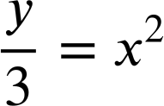

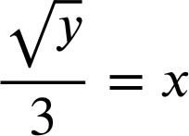
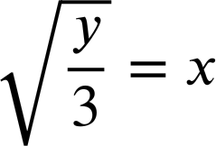
Rearranging more complex formula
When the term with exponent that is not 1 has a coefficient that is not 1 then order really matters.
For example, make x the subject.
y = 3x²
y = 3x²
Is this…
or…
Which is correct?

Slide 33
Rearranging more complex formula
Understanding the expression 3x² is useful in helping us understand why this rearrangement is correct.
3x²
Is this x squared then multiplied by 3?
y = 3x²
Or, x multiplied by 3 then squared?

Slide 34
Rearranging more complex formula
Understanding the expression 3x² is useful in helping us understand why this rearrangement is correct.
3x²
Is this x squared then multiplied by 3?
y = 3x²
÷3
x
squared
×3
3x²
Square root
x
Square root
÷3
3x²

Slide 35
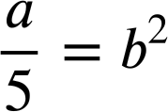
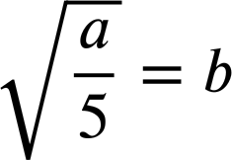
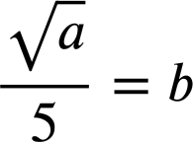
Rearranging more complex formula
Which is the correct rearrangement of this formula to make b the subject?
a = 5b²
a = 5b²
÷5 is the correct first step but the exponent of b must be 1

Slide 36
Rearranging more complex formula
Making x the subject is different for this formula.
y = (3x)²
x
×3
squared
(3x)²
x
÷3
Square root
(3x)²

Slide 37

Rearranging more complex formula
Which is the correct rearrangement of this formula to make b the subject?
a = (5b)²
a = (5b)²
Square root is the correct first step but the exponent of b must be 1

Slide 38
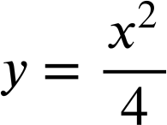
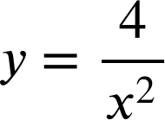



Rearranging more complex formula
1) Rearrange each formula to make x the subject.
a)
y = 4x²
b)
y = (4x)²
c)
y = 4x² + 1
d)
y = 4(x² + 1)
e)
f)
g)
h)
i)

Slide 39
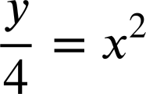

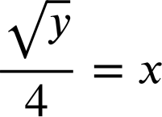
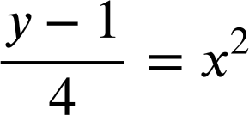
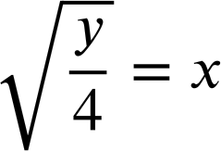
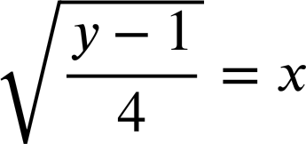
Rearranging more complex formula
1) Rearrange each formula to make x the subject.
a)
y = 4x²
b)
y = (4x)²
c)
y = 4x² + 1
y − 1= 4x²

Slide 40
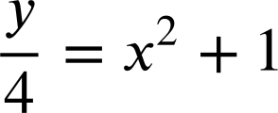







Rearranging more complex formula
1) Rearrange each formula to make x the subject.
d)
y = 4(x² + 1)
e)
f)

Slide 41






Rearranging more complex formula
1) Rearrange each formula to make x the subject.
g)
h)
i)

Slide 42

Changing the subject with more complex formula
We can apply an understanding of inverse operations to a complex formula in order to make a specific variable the subject.
For example, to make e the subject of this formula we will subtract 8 from both sides, then divide both sides by 5.
5e + 8 = d
5e = d − 8

Slide 43

© Oak National Academy 2024.
Produced in partnership with Mathematics in Education and Industry.
Licensed on the Open Government Licence v3.0, except where otherwise stated. See Oak terms and conditions.

